Slide 1
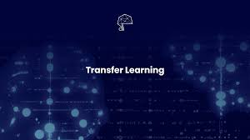
Prepared by : Muhammad Zaqeem

Slide 2
Overview:
Challenges in Custom Deep Learning Models
Transfer Learning
How Transfer Learning Works
Type of Transfer Learning
Pre-Trained Model
ImageNet
ImageNet Competition
Application of Transfer Learning

Slide 3
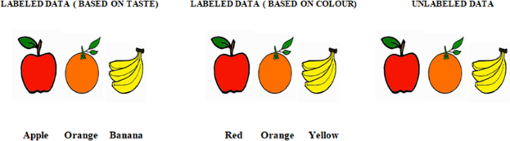
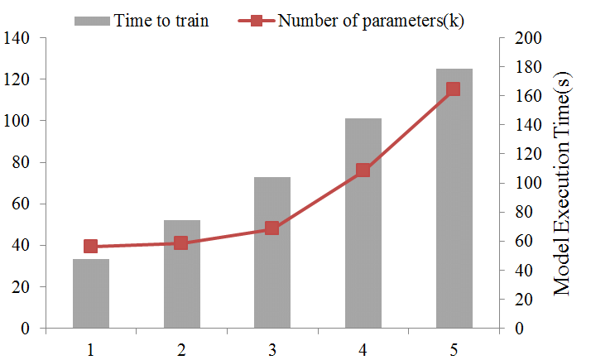
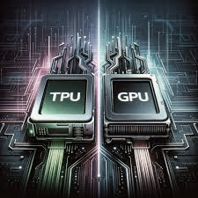
Challenges in Custom Deep learning Models
Insufficient Data:
For training our own model we need a lot of labelled training data which is both labour intensive and costly.
Computation Time:
Training your own model required a lot of computation time which can range upto weeks.
Computation Resource:
Training deep learning models often requires significant computational resources, including powerful GPUs or even specialized hardware like TPUs.

Slide 4
Solution

Slide 5
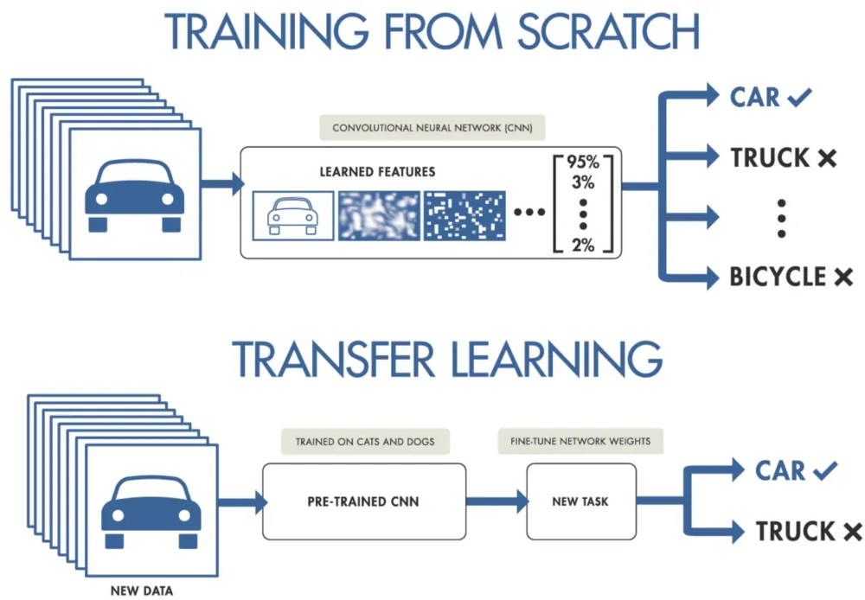
Transfer Learning:
Transfer Learning is a machine learning technique where a model trained on one task is reused or adapted to perform another task
Instead of training a model from scratch, we utilize the knowledge gained from solving a related problem.
It will not only significantly speed up training but also reduce the amount of training data required.

Slide 6
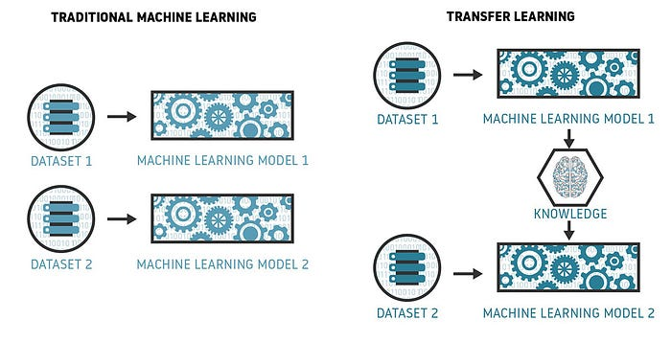
How Transfer Learning Works:
Select Pre-Trained Model:
Use a model like VGG-16 trained on a large dataset (e.g., ImageNet).
Remove Final Layers:
Exclude the task-specific layers to use the model as a feature extractor.
Add New Layers:
Add new layers for your specific task (e.g., binary classification).
Fine-Tune the Model:
Freeze pre-trained layers and train the new layers on your dataset.

Slide 7
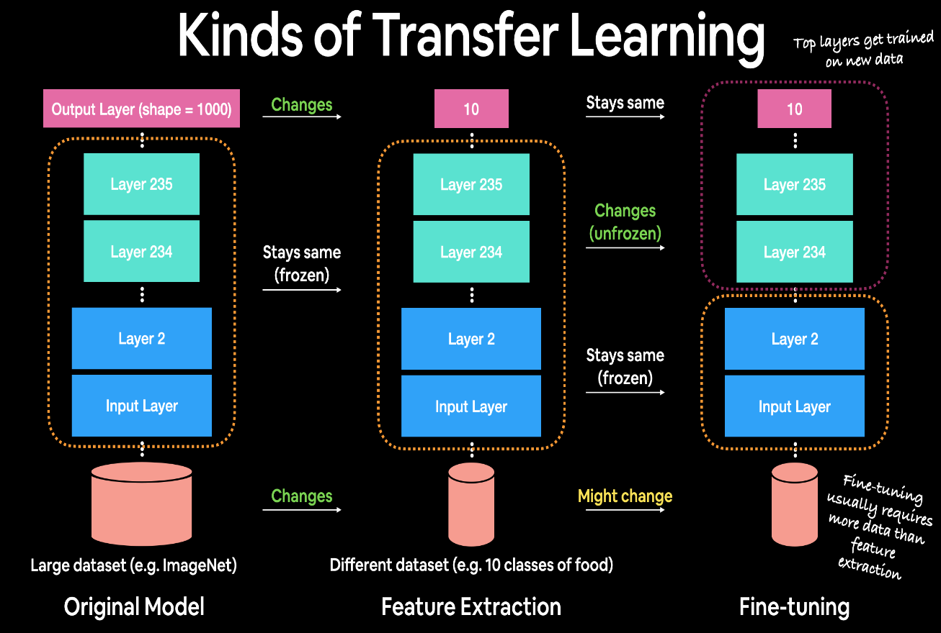
Type of Transfer Learning
Feature extraction:
In feature extraction, the pre-trained model is used to extract features from the data.
These features are then used to train a new model on the target task.
This is a good approach if you have limited data for the target task.
Fine-tuning:
Fine-tuning is a machine learning technique in which a pre-trained model is further trained on a new dataset to improve its performance on a specific task.
The pre-trained model is typically trained on a large dataset of general data, while the new dataset is specific to the task at hand.

Slide 8
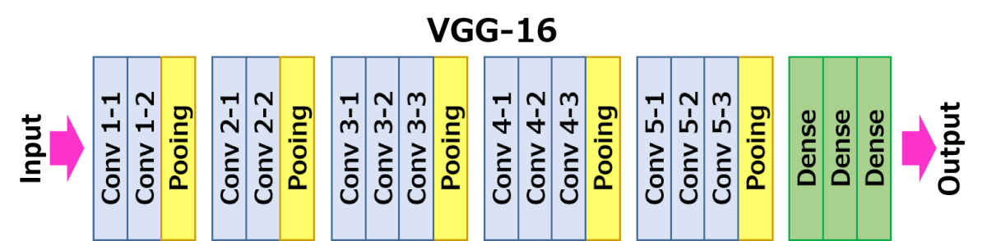
Pre-Trained Model:
A pre-trained model is a deep learning model that has been trained on a large dataset and can be fine-tuned for a specific task.
The pre-trained model learns to extract features from the data, and these features can be used to train the final layer of model for specific task more quickly and efficiently.
Popular Pre-Trained Architectures:
There are many popular pre-trained architectures, but some of the most common include.
1 VGG (Visual Geometry Group)

Slide 9
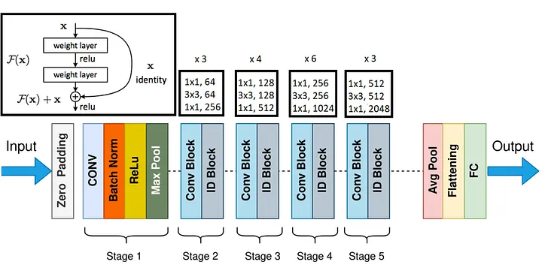
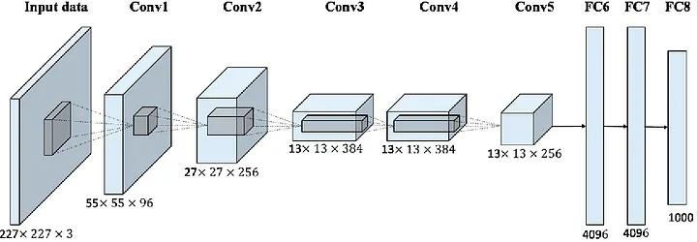
2 ResNet Model Architecture
3 Alexnet Model Architecture

Slide 10
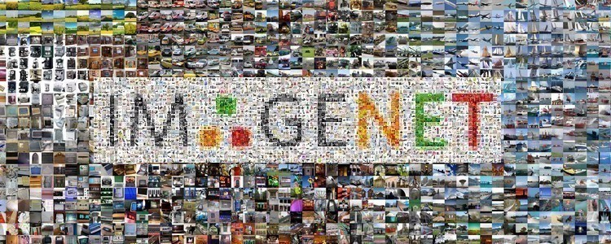
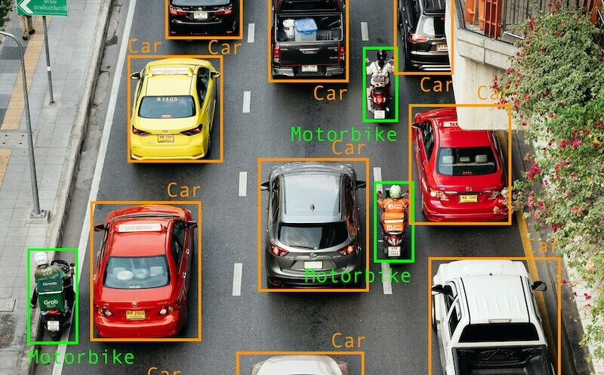
ImageNet
The ImageNet dataset contains over 14 million labeled images across 20,000 categories.
Co-founded in 2009 by Fei-Fei Li and other researchers, the project, initiated in 2006, has significantly advanced computer vision and deep learning research.
It also includes 1 million images with bounding box labels for object localization tasks, enabling the identification of objects and their precise locations within images.

Slide 11
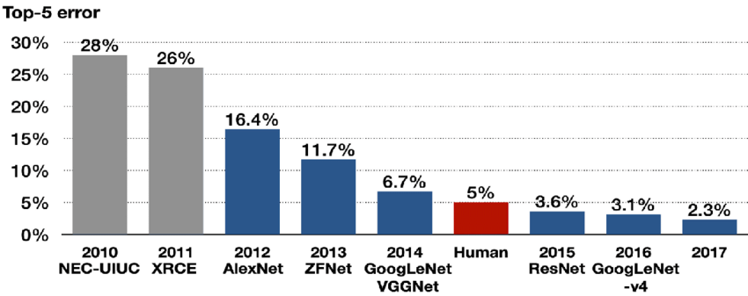
ImageNet Competition:

Slide 12
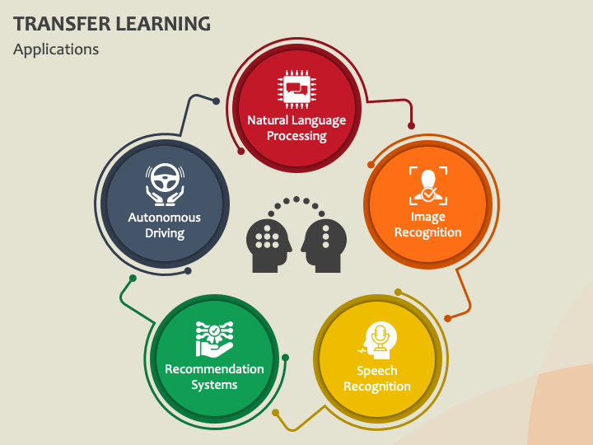
Application of Transfer Learning

Slide 13
References
https://medium.com/@davidfagb/guide-to-transfer-learning-in-deep-learning-1f685db1fc94#:~:text=To%20solve%20problems%20with%20limited%20data%3A%20Transfer%20learning%20can%20be,feature%20extraction%20or%20fine%2Dtuning.
https://medium.com/accredian/a-beginners-guide-to-transfer-learning-2d8f0b4f373b
https://blog.devgenius.io/all-you-need-to-know-about-transfer-learning-4a7e3cbaf1dd
https://medium.com/@davidfagb/guide-to-transfer-learning-in-deep-learning-1f685db1fc94
https://medium.com/@daniyalmasoodai/pre-train-cnn-architectures-designs-performance-analysis-and-comparison-802228a5ce92#:~:text=Pre%2Dtrained%20models%20can%20be%20used%20in%20a%20wide%20range,%2C%20and%20MobileNet%2C%20among%20others.
https://youtu.be/0MVXteg7TB4?si=TrnQ56EeWecVVIiH
https://youtu.be/WWcgHjuKVqA?si=UsWuy7yKsWcInIlu

